Slide 1

Vivekanand Education Society’s Institute Of Technology
Department Of Information Technology
DSA mini Project
A.Y. 2025-26
Finance Buddy: Data Structure-Based Finance Management System
The project “Finance Buddy” is an intelligent finance management system that began as a C-based Data Structure project and was later extended into a modern web application.
(Developed in C and Extended using HTML, CSS, and JavaScript)
By: Bhavesh Churyai (Information Technology Department) Project Type: DSA Mini Project
Name: Bhavesh Churyai
Rollno.:08
Div: D10B

Slide 2


Slide 3
Content
Introduction to the Project
Problem Statement
Objectives of the Project
Scope of the Project
Requirements of the System (Hardware, Software)
ER Diagram of the Proposed System
Data Structure & Concepts Used
Algorithm Explanation
Time and Space Complexity
Front End
Implementation
Gantt Chart
13. Test Cases
14.Challenges and Solutions
15. Future Scope
16. Code
17. Output Screenshots
18. Conclusion
19. References (in IEEE Format)

Slide 4
Introduction to Project
“Finance Buddy
The project “Finance Buddy” is an intelligent finance management system that began as a C-based Data Structure project and was later extended into a modern web application.
In the C version, the project uses linked lists and stacks to manage accounts, transactions, and undo operations — demonstrating pure data structure implementation. In the HTML/JavaScript version, the same logic was visualized with a modern, responsive interface featuring dashboards, charts, and goal planners.
This project connects real finance working in simple terms with the help of the platform provided and works with real world complexity
“
r Rates

Slide 5
Problem Statement
Managing personal finances manually is prone to human error and confusion, resulting in inaccurate tracking and poor financial decision-making. Moreover, traditional, static applications struggle to handle the dynamic growth of user data, such as an ever-increasing list of transactions and accounts. There is a clear need for a flexible, reliable, and accessible system that can:
Dynamically scale to handle an unlimited number of records.
Provide immediate tools for error correction and state reversal.
Offer clear visualization for quick analysis of spending.
This project solves this by creating a Dual-Platform Financial Management System

Slide 6
Objectives of the project
Rates
Implement a working finance management system using C and DSA.
Apply Linked List and Stack data structures for account and transaction management.
Build a Web UI (HTML/CSS/JS) to visualize the same operations and data structure logic.
Demonstrate real-world use of algorithms, data persistence, and visualization.
To implement a Singly Linked List of Transactions nested within each Account node.
To successfully implement a Stack data structure to enable the Undo Last Operation feature

Slide 7
Scope of the Project
Rates
Applicable for students, individuals, or small businesses to manage funds and goals.
The C version focuses on algorithmic accuracy and data structure design
The Web version emphasizes usability, visualization, and automation.
Together, they show how DSA principles evolve into modern application development.
Web UI Scope: Dashboard summary, categorized expense tracking, Savings Goal management, and integrated financial calculators.

Slide 8
Requirements of the system (Hardware, software)
Software:
HTML5, CSS3, JavaScript (ES6)
Web Browser (Chrome, Edge, or Firefox)
Chart.js Library (for graphs)
Hardware:
Minimum: 2 GB RAM
Intel i3 Processor or higher
500 MB Disk Space

Slide 9
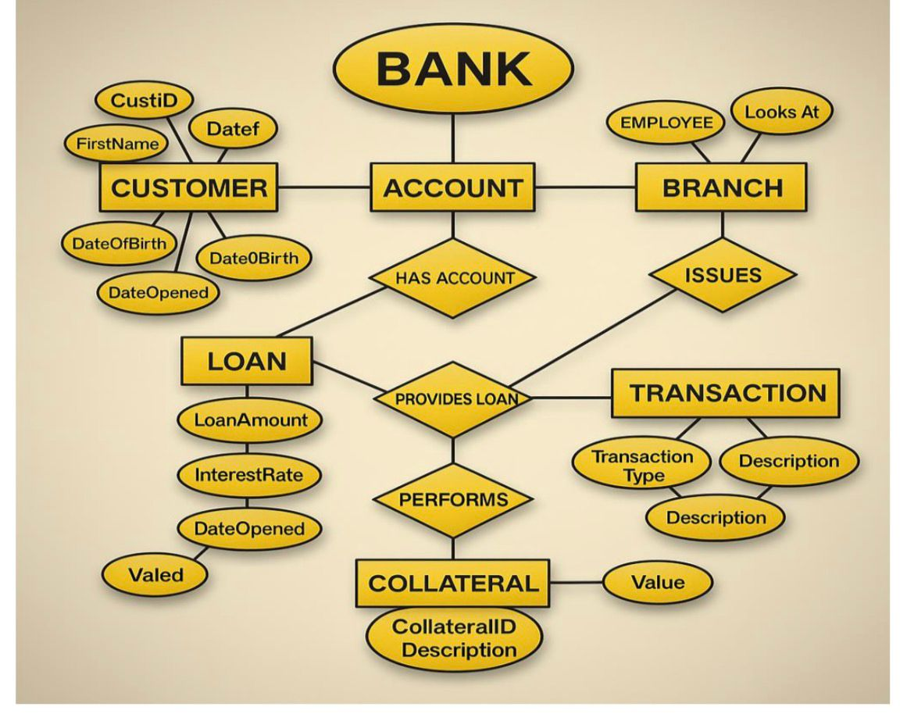
ER diagram of the proposed system

Slide 10
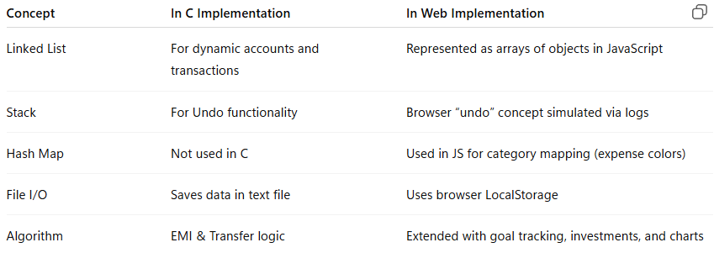
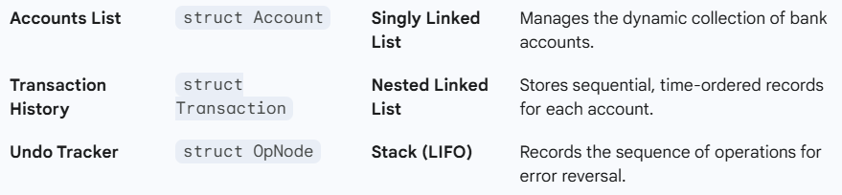
Data Structure & Concepts Used

Slide 11
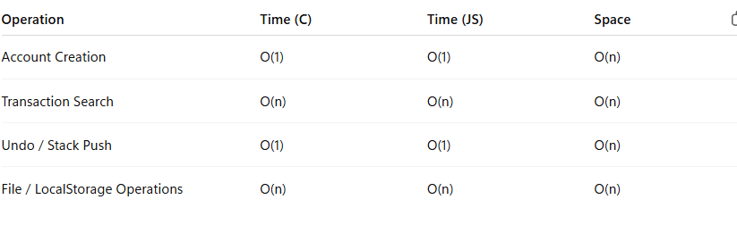
Time and Space Complexity

Slide 12
Front End
In C:
Command-line interface with text menus
Displays account and transaction data dynamically.
In HTML/JS:
Clean dashboard UI with sidebar navigation.
Cards and charts show account summary and spending distribution.
Responsive design using CSS grid & flexbox.
(Screenshot placeholders: Dashboard, Accounts, Loans, Goals)

Slide 13
Implementation
C Implementation:
Uses struct Account, struct Transaction, and struct OpNode.
Dynamic memory management using malloc() and free().
File handling using plain text format.
Undo operation via LIFO stack.
HTML/JS Implementation:
Uses objects and arrays to represent accounts and transactions.
Charts built using Chart.js.
State management via browser localStorage.
Smooth animations and modern UI for visualization.

Slide 14
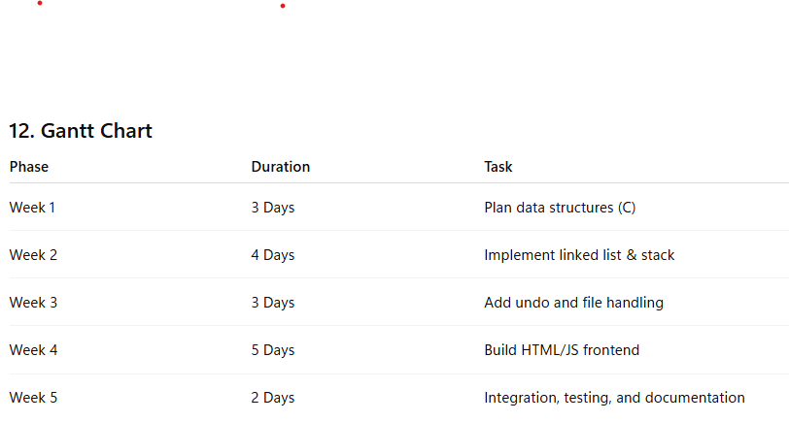
Gantt Chart

Slide 15
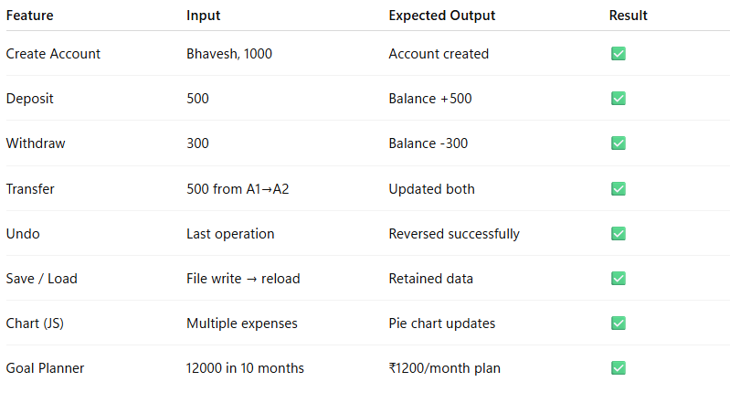
Test Cases

Slide 16
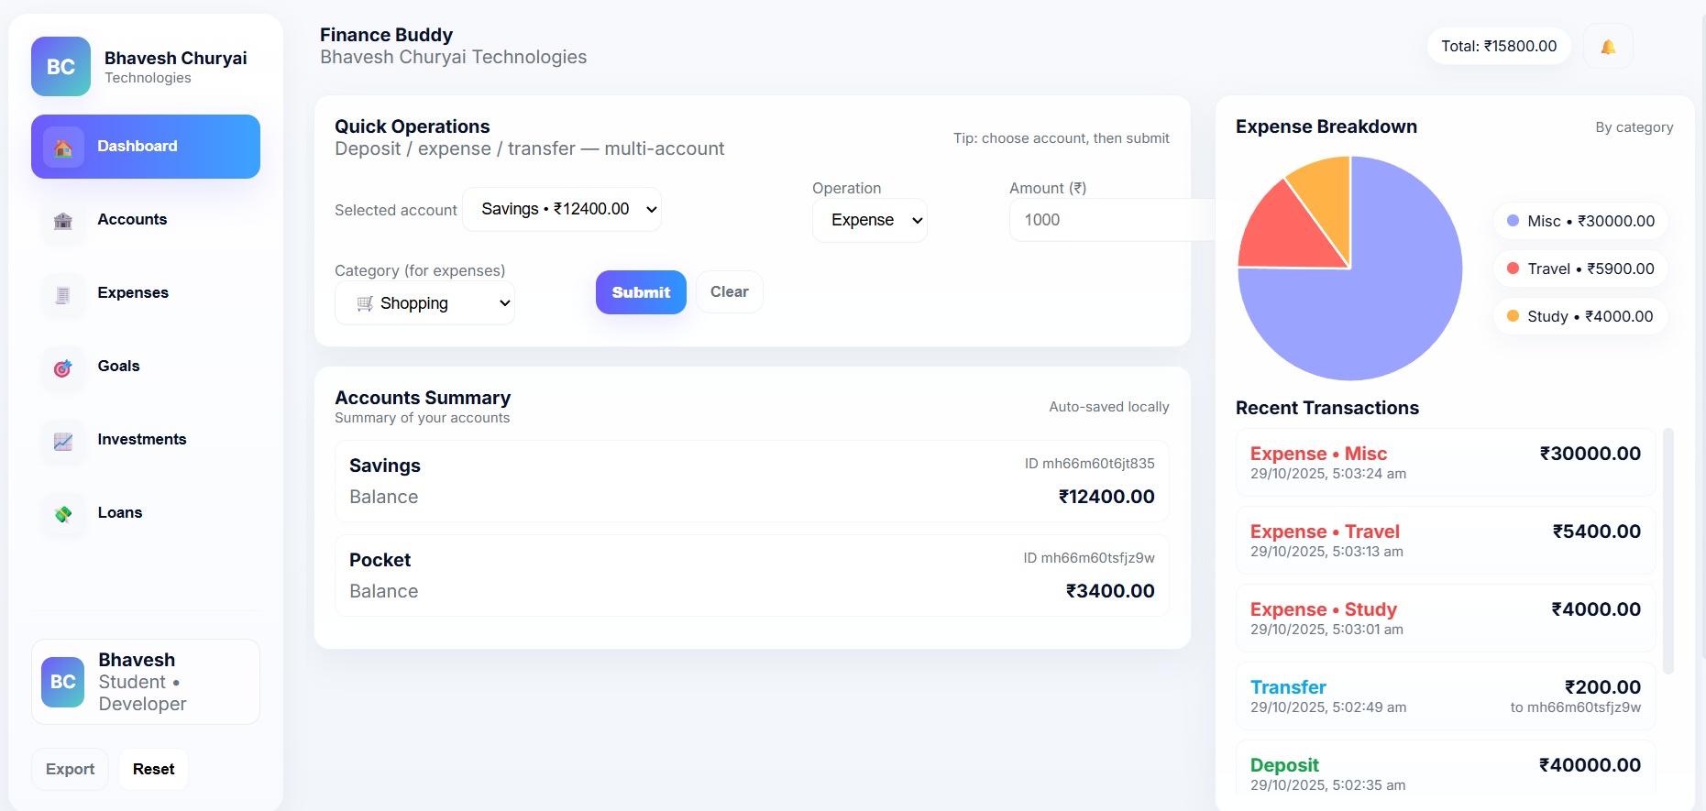
Output

Slide 17
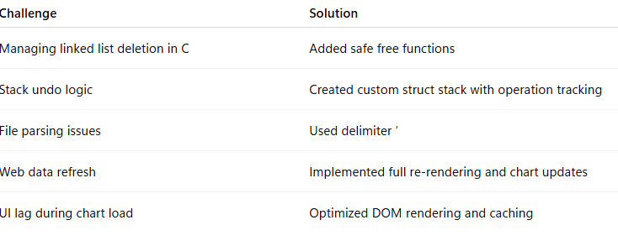
Challenges And Solutions

Slide 18
Conclusion
The Finance Buddy project successfully meets its dual objectives by building a high-integrity core using DSA principles (Linked Lists, Stack) in C, and combining it with a highly accessible and analytical Web UI. This demonstrates the effective application of low-level computer science theory to solve modern, real-world data management challenges. The Finance Buddy project integrates core Data Structure logic (C) with modern web development (HTML/JS). It demonstrates a strong grasp of linked lists, stacks, algorithm design, and their real-world applicability. Starting from a CLI-based system and evolving into a graphical, interactive platform, this project reflects both theoretical understanding and practical innovation.

Slide 19
References
B. Kernighan & D. Ritchie, The C Programming Language, Prentice Hall, 1988.
Mozilla Developer Network, “JavaScript Local Storage API,” 2024
.Chart.js Documentation — https://www.chartjs.org/
GeeksforGeeks, “Linked List and Stack in C,” 2023.
W3C Standards, “HTML5 and CSS3 Specifications,” 2024.
[Reference for C Programming Language Fundamentals]
[Reference for Data Structures: Linked Lists and Stacks]

